Slide 1





DATAGENZ AFRICA
Data Analysis Project
BLESSING AUSTIN-GABRIEL
Get Started
datagenzafrica.com

Slide 2


DATAGENZ AFRICA
Exploratory Data Analysis on the Identification of Risk Factors of Heart Disease
The study has helped identify several major risk factors for heart disease, including high blood pressure, high cholesterol levels, smoking, obesity, and diabetes.
The primary objective of the Framingham Heart Study is to identify common factors or characteristics that contribute to cardiovascular disease (CVD) and to track their influence over time.
These risk factors, collectively known as the Framingham Risk Factors, are now widely used in clinical practice to assess a person's risk of developing heart disease.
2020
Datagenzafrica.com
Next Page

Slide 3



DATAGENZ AFRICA
The Framingham Heart Study dataset from the National Heart, Lung, and Blood Institute website
01 - Dataset
4240 observations and 16 variables
Start Planing
Your Project
02 - Project Info
Analyze the relationships present in this dataset to get data informed decision.
03 - Objective
Datagenzafrica.com
Next Page

Slide 4
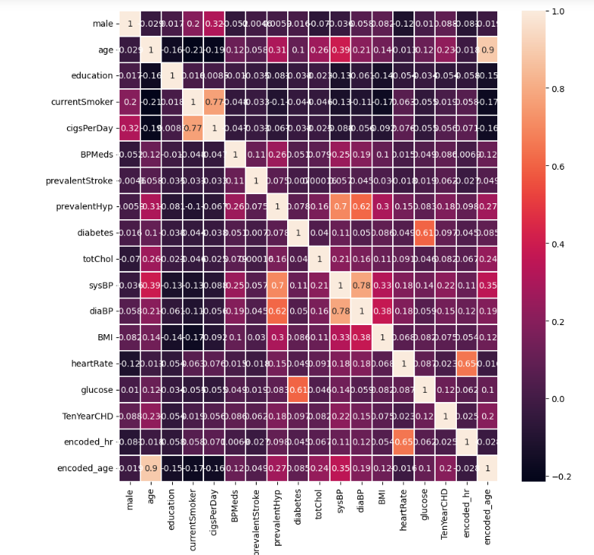

DATAGENZ AFRICA
From the pairplot/heatmap we see that sysBP and diaBP are highly correlated
CurrentSmoker and cigsPerDay are highly correlated

Slide 5
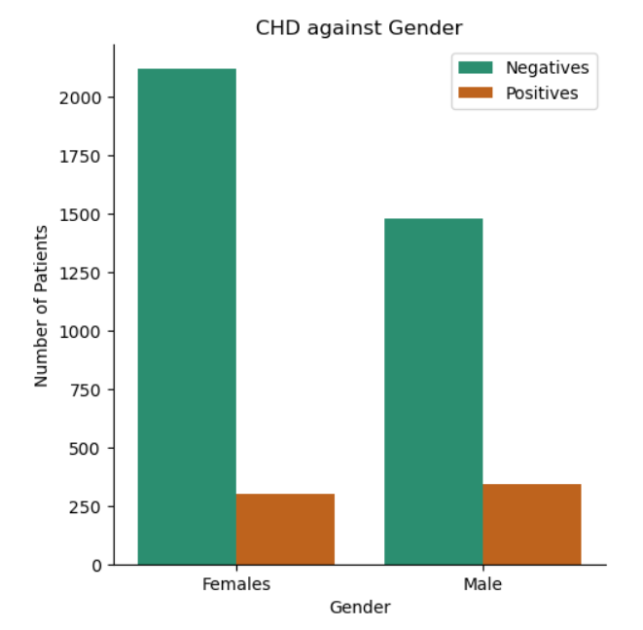
DATAGENZ AFRICA
Observation
Negative: The above analysis shows that more females are falling into the negative category than men.
Posiitve: It also shows that the same amout of males and females are suffering from CHD
Observations like this answer the question of 'Is a gender more predisposed to CHD than the other?'
Next Page

Slide 6
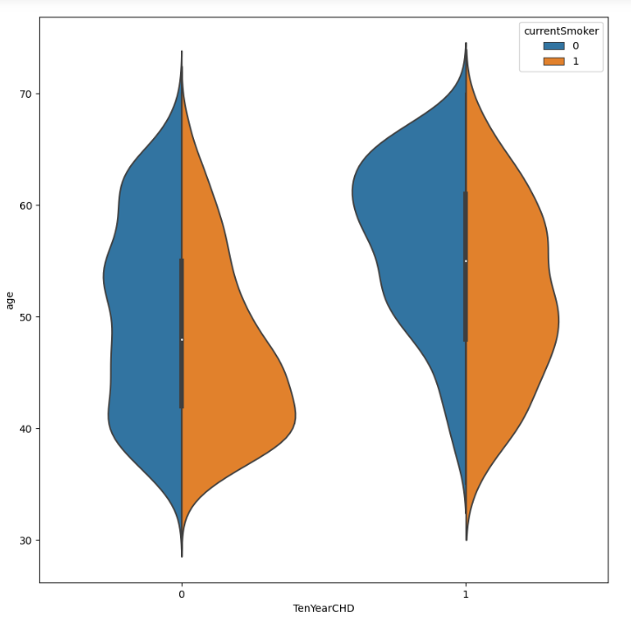
DATAGENZ AFRICA
Observation
Older patients demonstrate a higher propensity for developing Coronary Heart Disease (CHD). ers.
Moreover, smokers face a greater risk of CHD at a younger age when compared to non-smok
These findings emphasize the significance of age and smoking status as crucial risk factors for CHD development, warranting focused preventive interventions.
Next Page

Slide 7
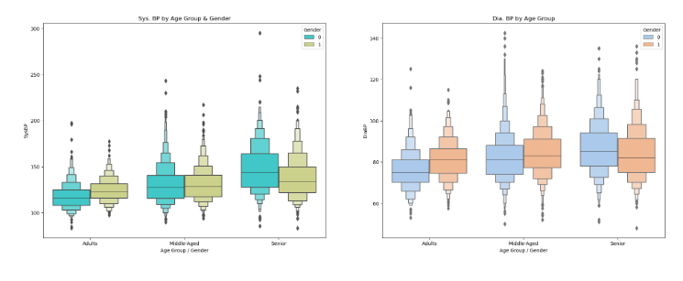
DATAGENZ AFRICA
Observation
This analysis answers the question of how Ststolic Blood Pressure and Diastolic Blood Pressure is affected by Age and Gender
SysBP is increasing by Age Group and Gender.
The DiaBP is also increasing by Age Group & Gender
Next Page

Slide 8
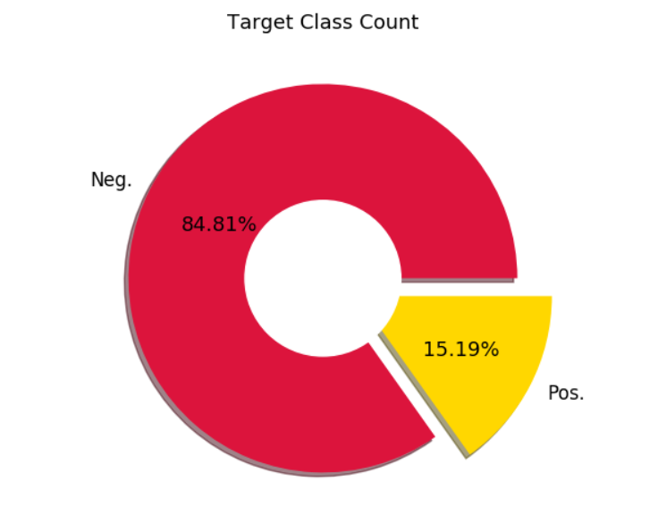

DATAGENZ AFRICA
01 - Observations
We can see that we've Imbalanced Dataset here having ratio of 85:15 where Positive Class is Minor
Ratio to Positive & Negative CHD recorded
02 - Solution
Learn More
To create a subset of this dataset and call it a test set which would be the set in which the model will be built based on the observation.
Next Page

Slide 9
DATAGENZ AFRICA
Thank You

